Slide 1

Cs 429:DATA MINING Lecture 15
Instructor:
Osama Ahmed Khan
osamaahmedkhan
Jul 20th, 2017

Slide 2
Algorithms
Inferring Rudimentary Rules
Statistical Modeling
Divide-and-Conquer: Constructing Decision Trees
Covering Algorithms: Constructing Rules
Mining Association Rules
Linear Models
Instance-Based Learning
Clustering

Slide 3
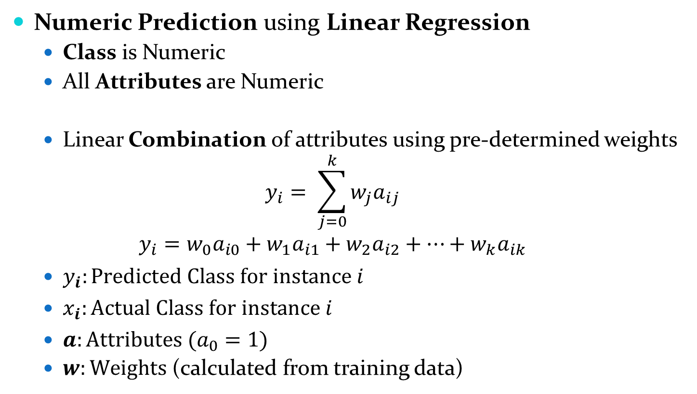
Linear Models
Numeric Prediction using Linear Regression
Class is Numeric
All Attributes are Numeric
Linear Combination of attributes using pre-determined weights
$$y_{i}= \sum_{j=0}^{k}{w_{j}a_{ij}}$$
$$y_{i}=w_{0}a_{i0}+w_{1}a_{i1}+w_{2}a_{i2}+…+w_{k}a_{ik}$$
$y_{i}:Predicted Class for instance i$
$x_{i}:Actual Class for instance i$
$a:Attributes (a_{0}=1)$
$w:Weights$ (calculated from training data)

Slide 4
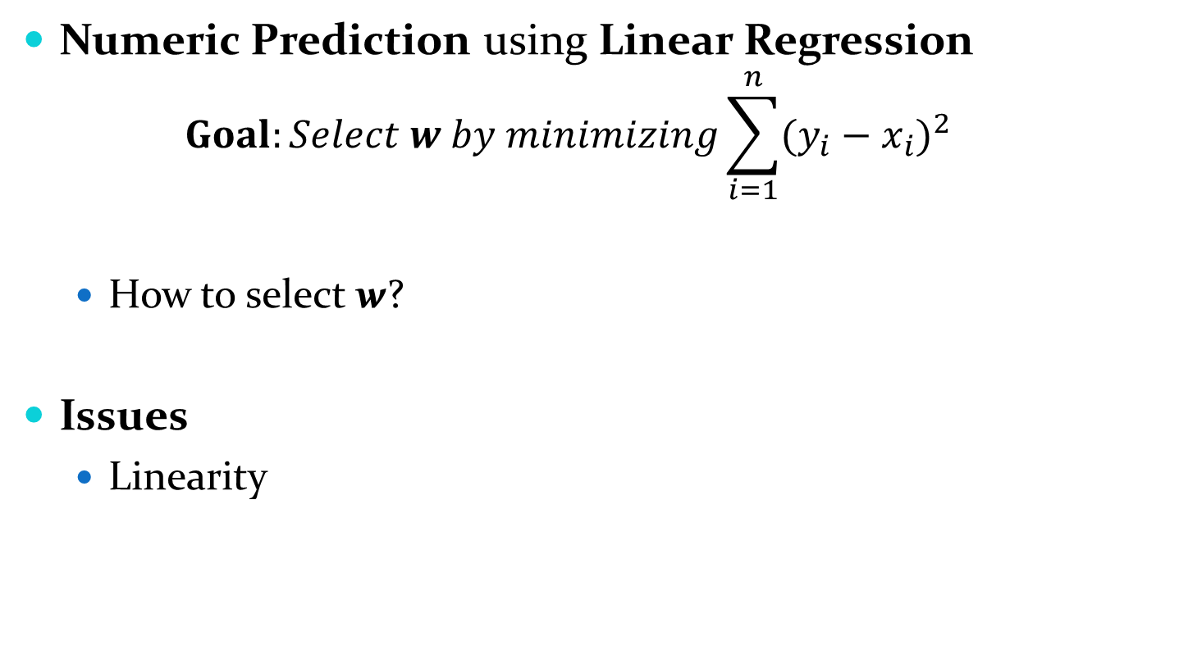
Linear Models
Numeric Prediction using Linear Regression
$$Goal:Select w by minimizing\sum_{i=1}^{n}{{(y_{i}−x_{i})}^{2}}$$
How to select w?
Issues
Linearity

Slide 5
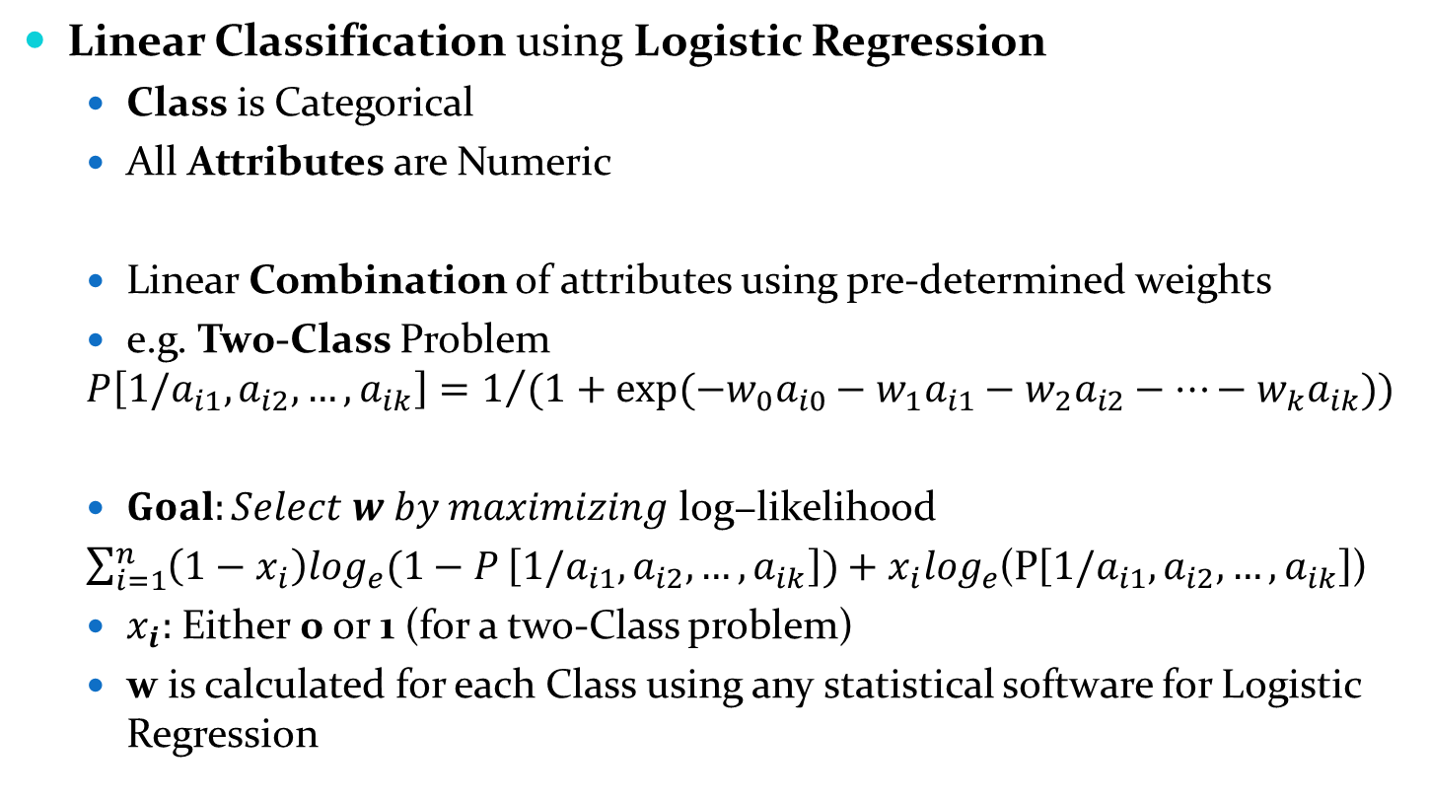
Linear Models
Linear Classification using Logistic Regression
Class is Categorical
All Attributes are Numeric
Linear Combination of attributes using pre-determined weights
e.g. Tw0-Class Problem
$$P\left[1/a_{i1},a_{i2},…,a_{ik}\right]=1/{(1+exp⁡(−w_{0}a_{i0}−w_{1}a_{i1}−w_{2}a_{i2}−…−w_{k}a_{ik}))}$$
$Goal:Select w by maximizing \text{log}\text{−}\text{likelihood}$
$\sum_{i=1}^{n}{\left(1−x_{i}\right)\log_{e}⁡(1−P}\left[1/a_{i1},a_{i2},…,a_{ik}\right])+x_{i}\log_{e}$(P$\left[1/a_{i1},a_{i2},…,a_{ik}\right]$)
$x_{i}:$ Either 0 or 1 (for a two-Class problem)
w is calculated for each Class using any statistical software for Logistic Regression

Slide 6
Linear Models
Linear Classification using Logistic Regression
e.g. k-Class Problem
Pairwise Classification
A Classifier is built for each pair of Classes [k(k-1)/2 Classifiers]
New Instance is classified based on majority votes for a Class
As fast in execution as any other multi-class technique
e.g. n instances are evenly divided among k Classes
2n/k instances per Classifier
e.g. n instances take n seconds to execute for a two-Class problem
n instances takes
k(k-1)/2*2n/k seconds to execute for a k-Class problem
= (k-1)n seconds
linear in terms of Classes or Instances
e.g. n instances take n² seconds to execute for a two-Class problem?

